Slide 1
Introduction
Policy Learning session objectives
Contribute to the development of evidence-informed educational policies by adding value to the policy briefs.
Help clarify the issues in hand and solutions.
Develop a shared understanding amongst stakeholders.
Contribute to developing effective policies, thus eventually contributing to good governance and democracy.
To this end:
Preview of the Policy Brief
Discussing and working on it through a participatory approach involving various stakeholders
Collecting inputs to finalise the policy recommendations
Presentation of the finalised Policy Brief to the EC

Slide 2
Strategic Support and Resources in STE(A)M Learning Ecologies
​2nd SLEs Policy Learning Session
​24th September 2024 (online)
Second SLEs Policy Brief - Overview
Stefania Laneve & Matteo Anzalone, Project Managers, APRE – Agency for the Promotion of European Research

Slide 3
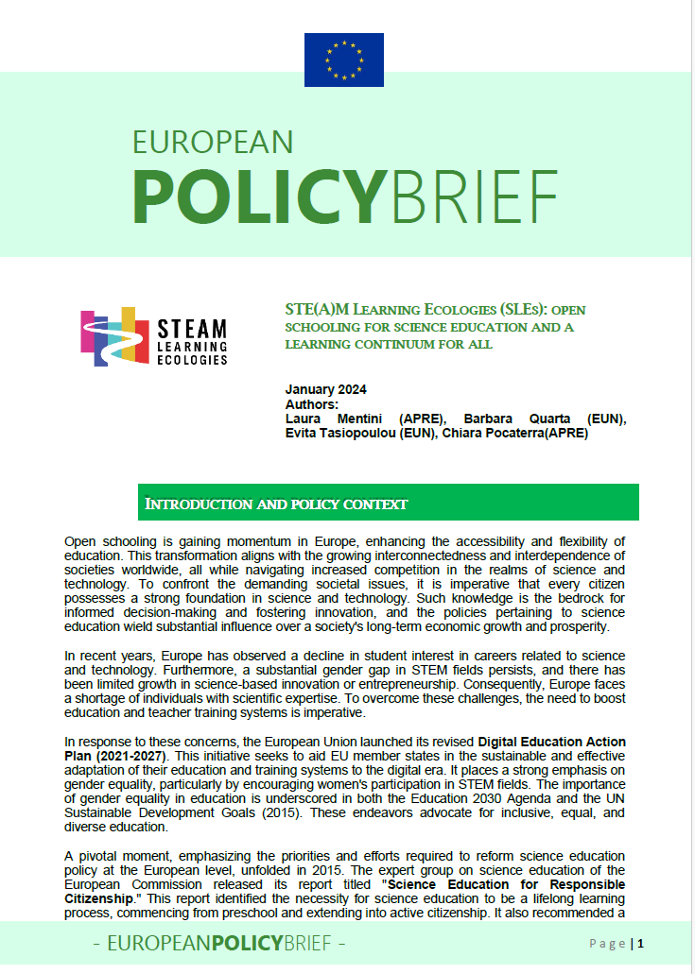
1st Policy Brief Overview
KEY RECOMMENDATIONS
EU LEVEL
- Policy support and guidance to national ministries on OS in science education
- Mainstream existing approaches on OS and STE(A)M
- Coordinated Approach between DGs to align EU-funded projects with broader holistic approaches
NATIONAL LEVEL
- Formulate national STEM/STE(A)M policies
- Integrate OS in the curricula
- Boost funding for school collaboration
EDUCATION AUTHORITY
- Develop a shared vision and goals for STE(A)M education
- Promote female role models in STEM
- co-create policies with relevant stakeholders to include funding for curriculum development, CPD, school facilities and raising public awareness around OS and STE(A)M
EDUCATIONAL PRACTICE & EDUCATOR LEVEL
- Implement innovative learning approaches merging STEM, humanities and other subjects
- Maximise the use of existing OS and STE(A)M resources available on European platforms
- Cultivate collaborative school partnerships with community organisations

Slide 4

2nd Policy brief’s objectives
It builds on the 1st Policy brief (Year 1) and on the results achieved during the first year of project’s implementation.
MAIN OBJECTIVEs
Ensure that science becomes more accessible, relevant and inclusive, aligning with societal needs and encouraging broader participation in the scientific process.
Supporting the institutionalization and sustainability of the SLEs approach, providing a framework for broader adoption and integration into educational systems.
Notes:
In the overall vision of SLEs these 3 elements are synthesized into local partnerships as SLEs.
- STEAM as an overarching approach across STEM subjects, the arts and all other non-STEM disciplines that can greatly increase interdisciplinarity, creativity, problem-solving, critical thinking, integration in school education and life-long learning, by engaging learners in real-life problem-solving situations
- OS as the main pillar and environment promoting partnerships between different societal actors and the local community to create engaging and effective educational experiences with the aim of empowering students to have a role on the STEM fields.
- The living Lab approach as a key practice that emphasizes the central role of the user and the co-creation process
The concept of learning ecologies offer a powerful new way to design and develop local open schooling partnerships as science learning continuum for all.
Such fusion offers a unique opportunity to bridge the gap between education and business and develop connected science learning ecosystems where learners have access to different learning experiences and are supported and mentored by experts and peers in ways that can lead to future opportunities at personal, academic, professional and civic level.
Open schooling is based on the core premise that collaboration of formal education providers with a diverse array of stakeholders, including civil society organizations and enterprises, would allow learners to engage in real-life problem-solving and stimulate interest in science (European Commission, 2015). In the same report where it endorsed open schooling, the European Commission also highlighted the need to move from STEM to STE(A)M, in order to integrate science, technology, engineering, and mathematics with all (“A”) other subjects and disciplines add title of this high level report.
Open schooling is expected to bridge formal learning with non-formal and informal learning across educational levels, make learning much more relevant for learners and foster scientific literacy and skills, including 21st century skills (European Commission, 2024). The transformative change that open schooling is hoped to achieve includes bringing learners beyond school walls, as well as offering lifelong learning opportunities to all citizens through active community engagement (STE(A)M Learning Ecologies, 2024).

Slide 5



Data collection for the analysis
DATA were collected through:
Open-ended questionnaire distributed to external stakeholders (outside the project’s Consortium) in the different pilot countries, including policymakers and practitioners.
A multiple-choice survey assessing the evaluation of the pilot implementation. Questions focused on the learning objectives and competences achieved by students, learning methods adopted, female inclusion, teacher professional development, stakeholder collaborations and implementation challenges.
Qualitative interviews to pilots’ stakeholders.
Online co-creation reflection workshop (June 2024) with all project partners to assess the main outputs of the SLEs implementation, addressing aspects such as the main benefits of the SLEs and strategies for replication and sustainability.
Notes:
Open-ended questionnaire distributed to external stakeholders (outside the project’s Consortium) in the different pilot countries, including policymakers and practitioners, to assess the current state of policies in the countries, as well as perceptions on good practices and challenges related to open schooling and STE(A)M implementation in schools. A total of 11 questionnaires have been analysed to this purpose.
A multiple-choice survey assessing the evaluation of the pilot implementation in the countries was delivered to project partners, including questions on the learning objectives and competences achieved by students, learning methods adopted, female inclusion, teacher development, stakeholder collaborations and implementation challenges.
Qualitative interviews to pilot stakeholders used as primary data collection input.
Online co-creation reflection workshop (June 2024) with all project partners to assess the main outputs of the SLEs implementation, addressing aspects such as the main benefits of the SLEs and strategies for replication and sustainability. All these data were analysed considering both their quantitative or qualitative aspects, and the main results are reported in the sections here below.

Slide 6
European Policy context
European Research Area (ERA)
Obj. 4: Deepening the ERA
Strengthen the participation of women in STEM
European Education Area (EEA)
Promoting gender equality to challenge and dissolve gender stereotypes
Starting from the education systems to change behaviours and boost skills for the green economy
OSOS Network
Fostering collaboration
Promoting inquiry-Based learning
Involve young generations in promoting participatory actions to transform our economy and society.
ERA Policy Agenda 2022-2024
Action 14: Bring Science closer to citizens through citizen science initiatives, improved science communication, education and training activities.
Innovative and multi-disciplinary teaching and learning approaches for basic skills
Encouraging non-formal learning
Bringing science to schools
Enhancing teacher professional development
Encouraging student engagement

Slide 7
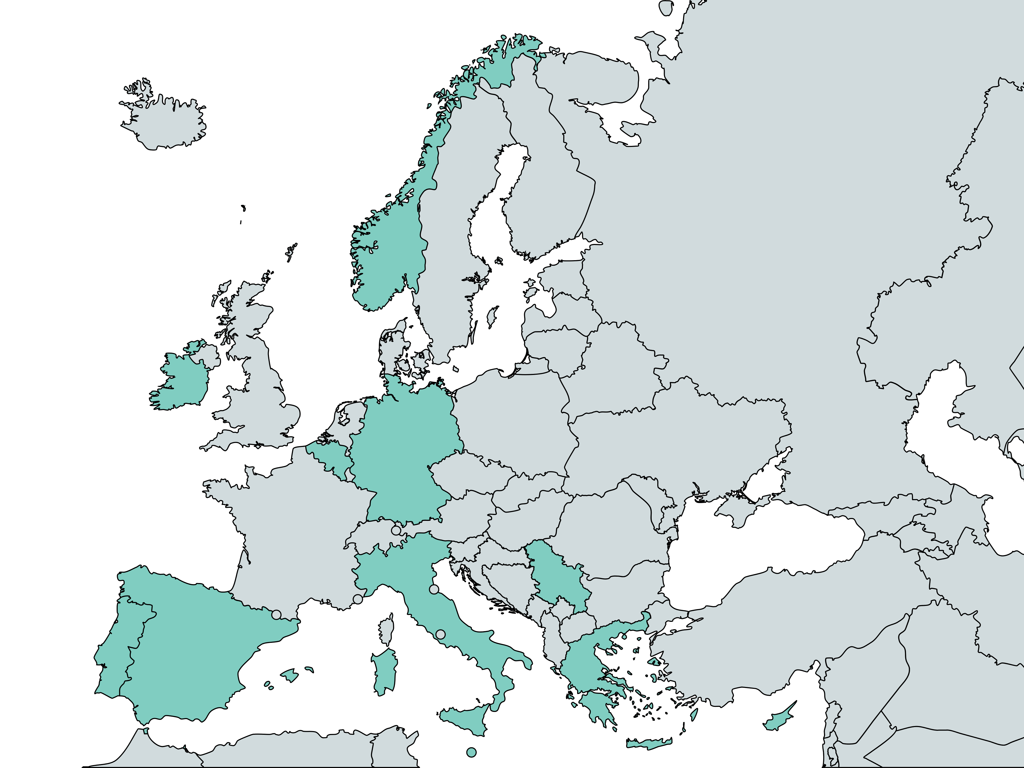
National and local policy contexts
Concrete public resources’ allocation (e.g. distribution of innovative tools such as 3D printers and robotic kits to schools)
Current state of OS and STE(A)M in Europe: where are we?
Curricula including innovative approaches (e.g. integration of AI with artistic subjects in high schools’ courses)
Regional centres for educational innovation and STE(A)M education
EU-funded projects and non-formal initiatives promoting STE(A)M education outside classrooms and multi-stakeholder collaborations (e.g. EU4Ocean Coalition, Youth4Ocean Forum, ambient teaching in Serbia)
Professional development for teachers and educators. Strong focus on Arts, Technology, AI ensuring integration of STE(A)M elements in teaching practices (e.g. Scuola Futura funded by Next Generation EU)
ALL countries → growing integration of artistic elements into STEM subjects BUT formal integration in school curricula is not mature due to rigid subject-oriented structures

Slide 8
Pilot implementation
During the last school year a total of 12 pilot SLEs were implemented in 12 different countries:
In the pilots a total of 1076 learners were engaged and a diverse range of stakeholders took part:
28 formal education providers
20 non-formal education providers
18 governmental organizations
7 Civil Society Organizations
23 Industry actors

Slide 9
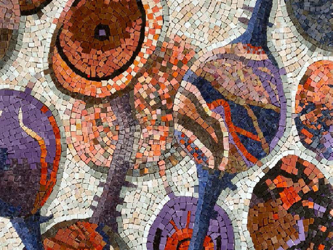
Artefacts’ examples
Mosaic of the community brain
Sustainable book crossing house
DYI seismometer
Notes:
Definizione artefatti: prodotti di apprendimento educativi sviluppati attraverso un approccio co-creativo.

Slide 10
Obstacles and challenges
Policy, Time, and Resources: Lack of time for planning along with bureaucratic delays, hinders progress.
Insufficient Support: Limited resources, inadequate professional development, and community engagement make it difficult to sustain STE(A)M projects.
Rigid Curricula: Centralized policies create rigid subject-based curricula, limiting flexibility for STE(A)M approaches.
Financial and Stakeholder Issues: Funding constraints and difficulties in collaborating with industry partners slow progress and complicate stakeholder coordination.
Teacher Recognition: Lack of legal recognition and compensated working hours reduces teachers' involvement in innovative education efforts.
Notes:
La maggior parte degli ostacoli sono dovuti principalmente a difficoltà strutturali.

Slide 11
Policy recommendations
Increased Funding: Advocate for long-term financial support for schools and teachers ensuring the successful implementation of Open Schooling and SLEs.
Curriculum Flexibility: Promote policies allowing for interdisciplinary, inclusive, and thematic learning, shifting away from rigid subject-oriented approaches.
Sustainable Innovation: Integrate educational innovations into the formal curriculum to ensure continuity beyond volunteer efforts and extracurricular activities.
Gender Balance: Strengthen policies addressing gender disparities in science education, promoting female participation and breaking stereotypes.
Collaboration: Enhance partnerships between schools, research institutions, and industry to enrich learning experiences with real-world applications.
Innovative Approaches: Provide training in experiential, game-based, and design-based learning to make STE(A)M education more interactive and engaging.
Support Systems: Develop a robust support system with professional development and administrative assistance for teachers.
Community Engagement: Encourage partnerships between schools, local communities, and external actors to foster collaborative educational environments.
Inclusivity: Promote policies supporting diversity and inclusivity in education, particularly for increasing female participation in STE(A)M initiatives

Slide 12
Policy recommendations
Scaling up and sustainability
DIVERSE STAKEHOLDERS: Ensure participation of at least 3-4 stakeholders, including educators, industry, researchers, and community members. Tailor support to schools based on their experience level and include schools from less central areas for diverse representation.
GUIDELINES & FLEXIBILITY: Develop clear, flexible guidelines for stakeholder cooperation and establish a network to share good practices, promoting peer-to-peer learning.
SUSTAINABILITY: Integrate successful practices into the regular curriculum and promote small-scale, low-cost SLEs for long-term sustainability.
TEACHER RECOGNITION: Recognize and reward teachers' efforts in STE(A)M initiatives to boost motivation and commitment.

